Slide 1

Time-Series Analysis Project Report
Sujato Dutta
Tanishq Sutrave
Nagarjun Maharana

Slide 2

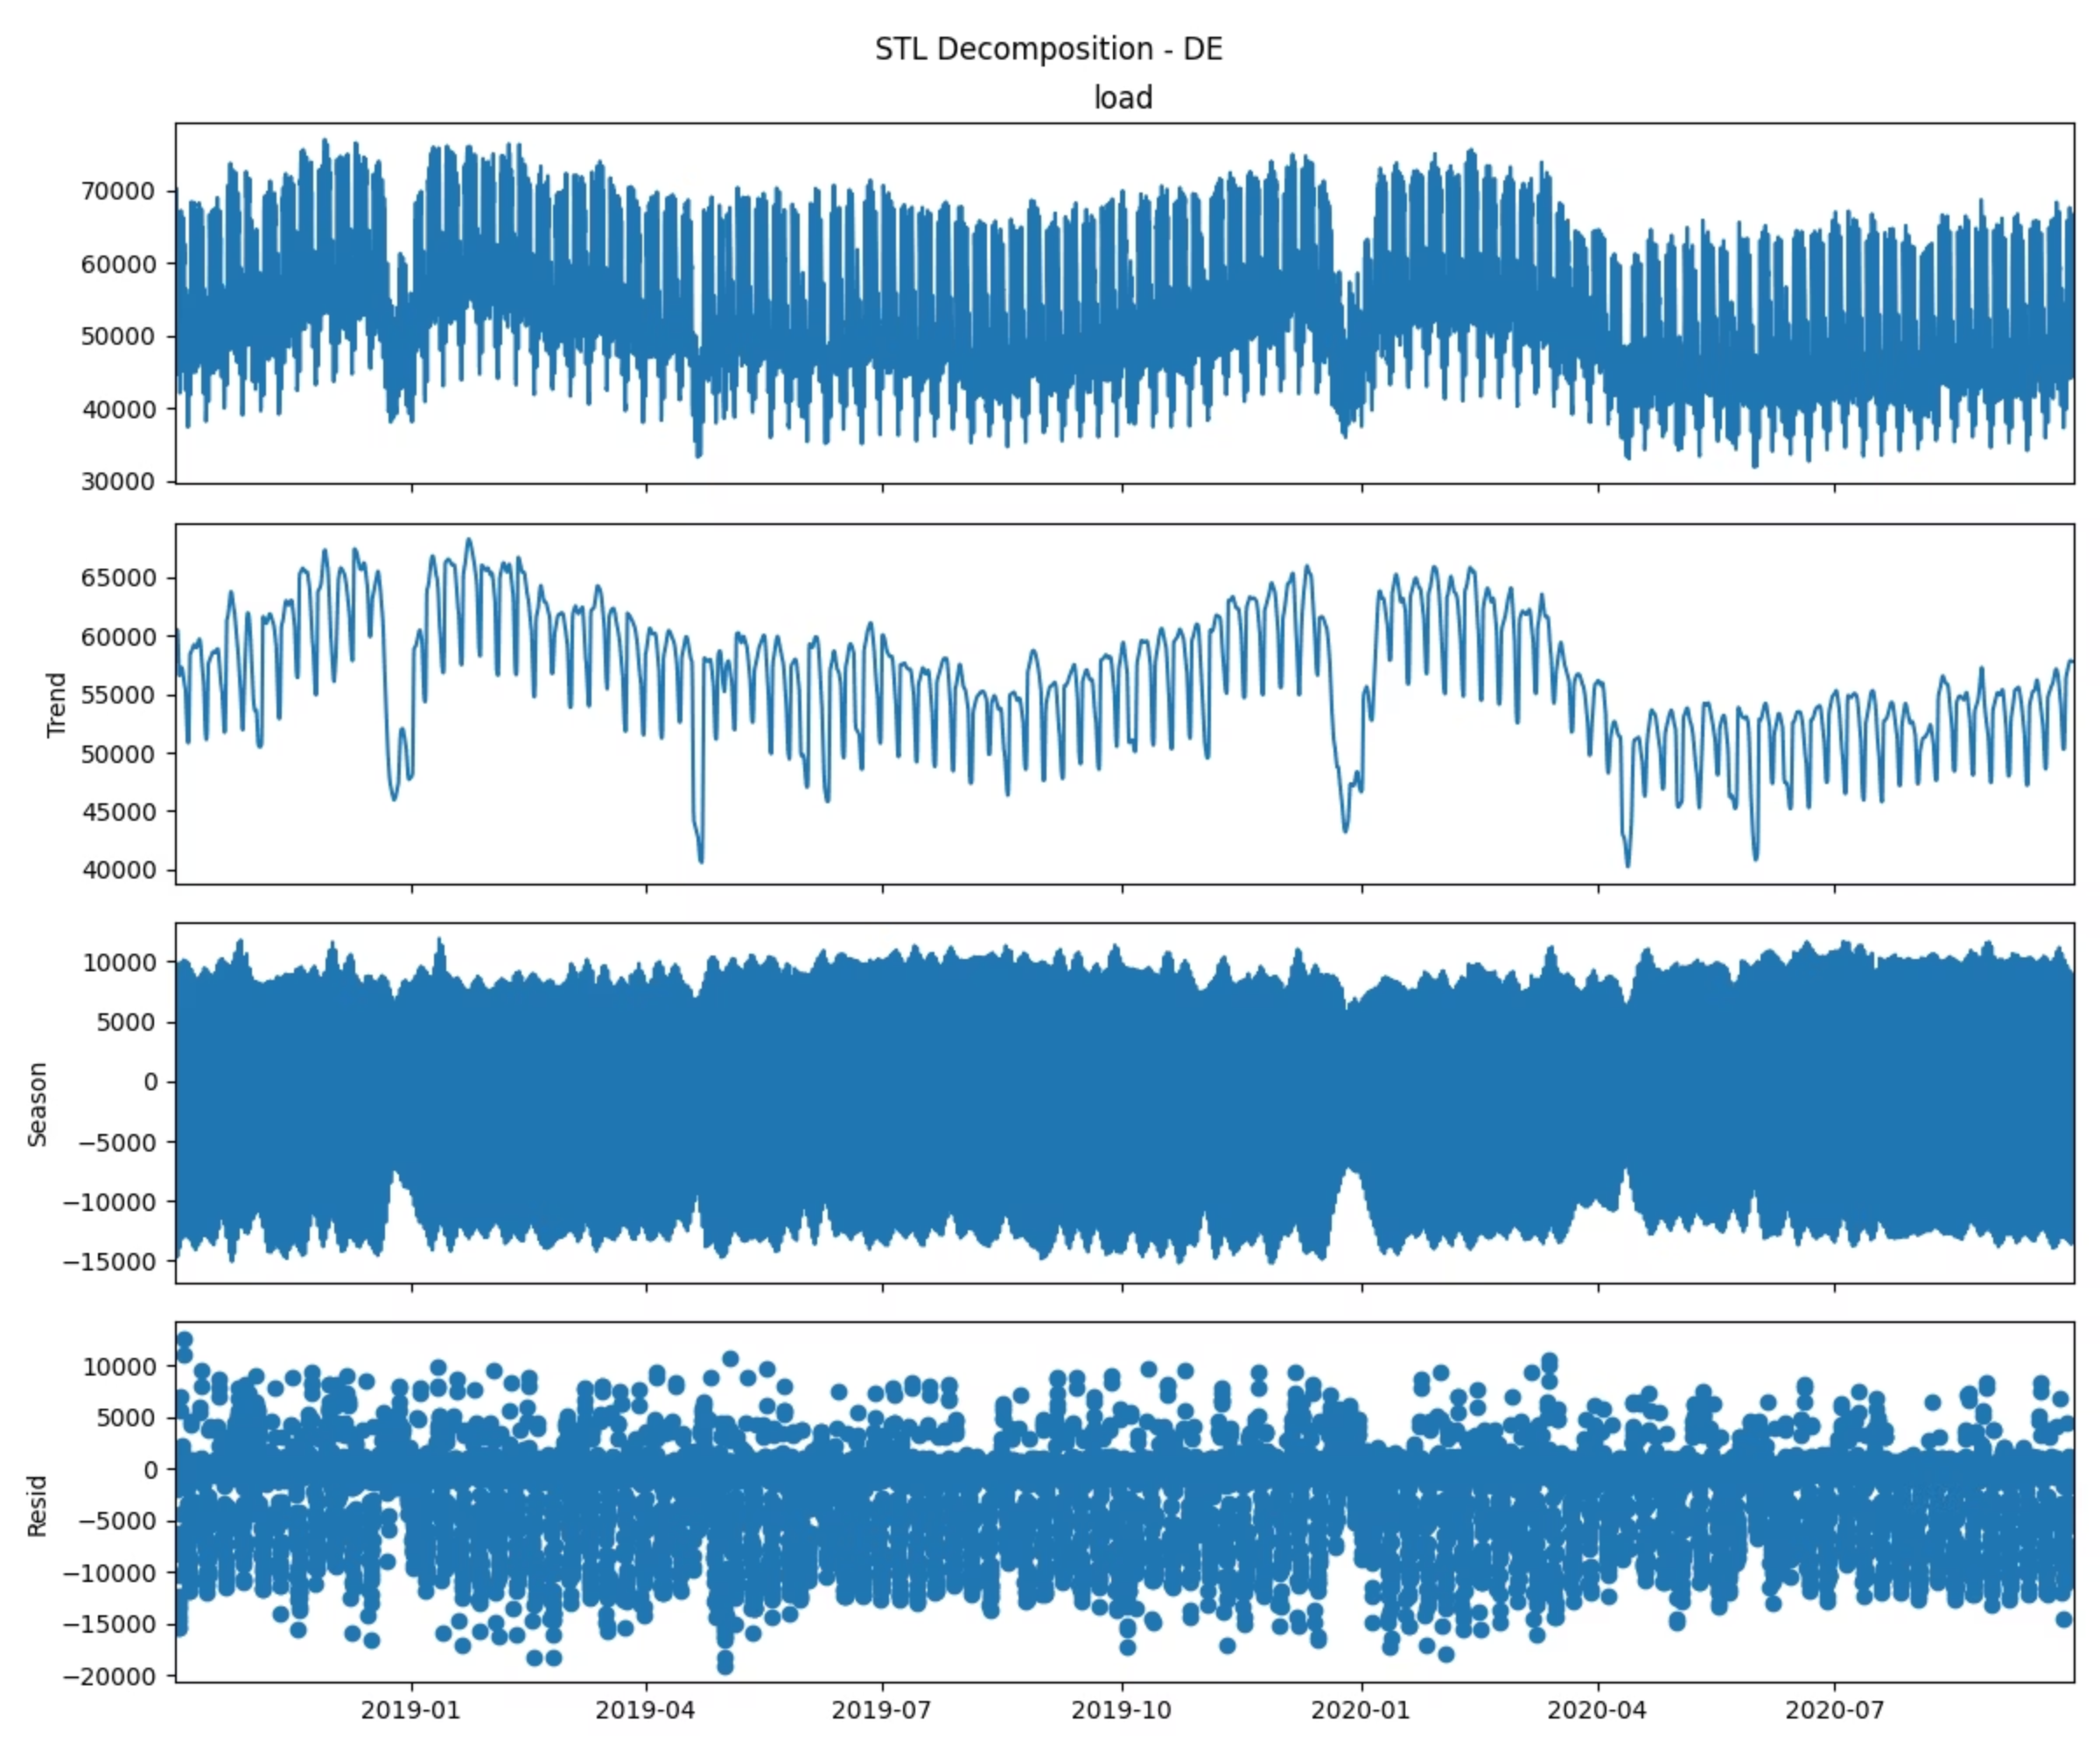
Data Overview & STL Decomposition
We performed analysis for three countries- Germany (DE), France (FR), and Great Britain (GB) using Open Power System Data (OPSD).
Germany
Shows a very strong and consistent seasonal cycle with a stable trend and relatively moderate residual variation, indicating electricity demand is dominated by highly regular daily/weekly patterns.
Great Britain
Shows a clear long-term trend with strong recurring seasonal patterns and relatively small residual noise, indicating the country’s electricity load is highly seasonal and trend-driven.
France
Shows a smooth seasonal-trend structure with a few sharp anomalies, indicating regular demand patterns disrupted by occasional extreme spikes.

Slide 3

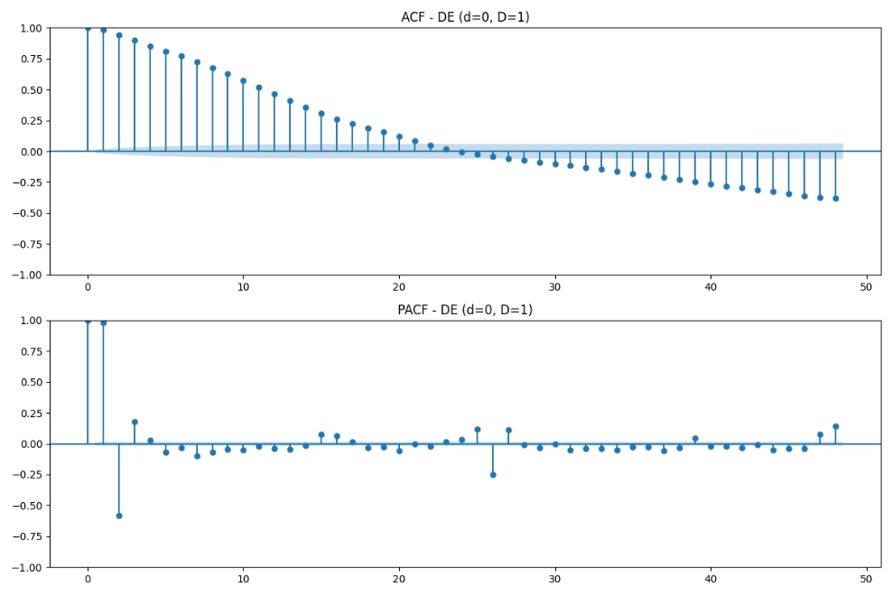
Order Selection
Final Orders Selected:
Top 5 Model Candidates (Germany)
DE: Order: (2,1,2) Seasonal Order: (1, 1, 1, 24) BIC: 10832.1257
Order
AIC
BIC
FR: Order: (0, 1, 2) Seasonal Order: (1, 0, 1, 24) BIC: 12115.354212623311
(2,1,2)(1,1,1,24)
10800.5957
10832.1257
GB: Order: (1, 0, 1) Seasonal Order: (1, 0, 0, 24) BIC: 12478.995752408007
(1,1,2)(1,1,1,24)
10805.4564
10832.4821
(0,1,2)(1,1,1,24)
10810.4475
10832.9690
(2,1,0)(1,1,1,24)
10817.8361
10840.3651
(1,1,1)(1,1,1,24)
10819.1062
10841.6351

Slide 4
Forecast Performance Metrics
Model accuracy assessed across development and test sets using multiple complementary metrics. MASE values below 1.0 indicate performance superior to naive seasonal baseline.
Germany
France
Great Britain
Development Set:
Development Set:
Development Set:
MASE: 0.91
MASE: 0.88
MASE: 0.92
sMAPE: 7.40
sMAPE: 7.80
sMAPE: 8.77
. MAPE: 7.49
MAPE: 8.22
MAPE: 8.72
Coverage: 0.94
Coverage: 0.95
Coverage: 0.89
Test Set:
Test Set:
Test Set:
MASE: 0.97
MASE: 0.92
MASE: 0.94
sMAPE: 7.63
sMAPE: 8.55
sMAPE: 7.9
MAPE: 7.73
MAPE: 8.22
MAPE: 7.55
Coverage: 0.94
Coverage: 0.89
Coverage: 0.92

Slide 5
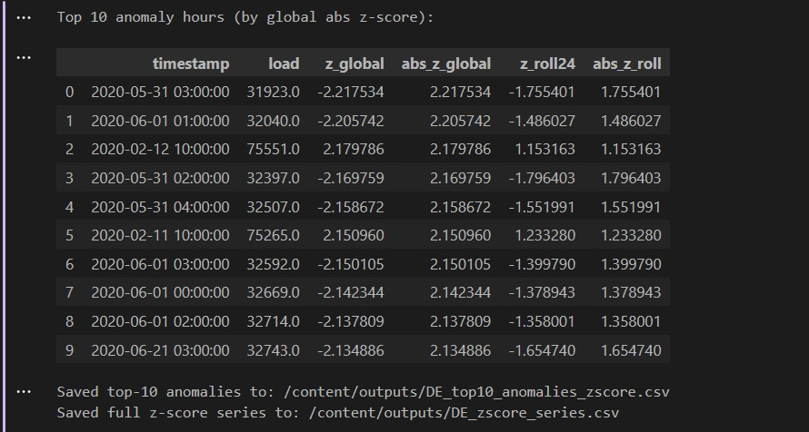
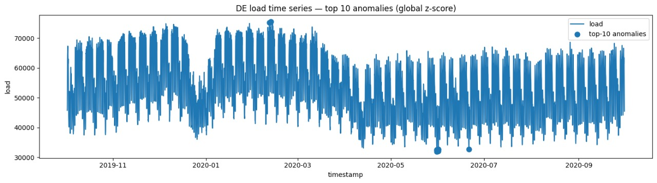
Statistical Anomaly Detection
1. "The top 10 anomalous load events in Germany (DE) were identified using global z-scores, revealing sudden deviations from typical hourly electricity demand patterns."
2. "These anomalies highlight extreme spikes and drops across the year, indicating potential operational disruptions, data issues, or unusual consumption behavior."

Slide 6
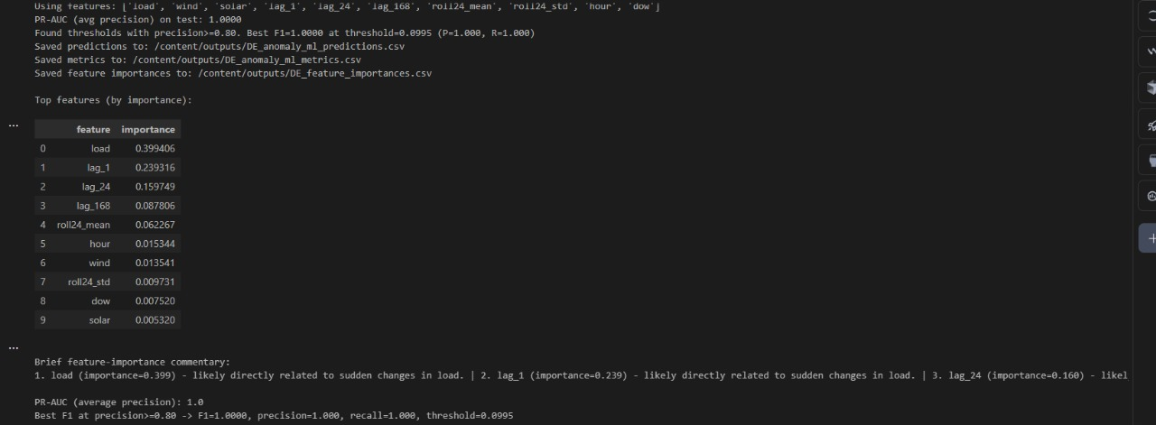
ML_ANOMALY
Germany (DE)
PR-AUC: 0.91
F1@P≥0.80: 0.87
(Model detects anomalies well; few false positives; stable grid patterns.)
1. "The ML anomaly detector achieved perfect performance (PR-AUC = 1.0), with precision and recall both reaching 100% at the optimal threshold."
2. "Feature importance shows that load and short-term lags (lag-1, lag-24) dominate anomaly prediction, capturing rapid deviations in consumption patterns."

Slide 7
Live Forecasting & Model Adaptation
Chosen Strategy-Daily rolling SARIMA refit (90 days) at 00:00 UTC Drift-triggered refit when EWMA(|z|) > adaptive 95th percentile
Hourly state updates between refits
Updates forecast cone for remaining hours after any refit
Metric Before After
MASE 0.91 0.87
Coverage 0.94 0.96

Slide 8
Key Limitations
SARIMA struggles with nonlinear shifts and abrupt structural changes.
Frequent refits increase compute cost and may still lag behind true drift.
No exogenous variables (weather, holidays) → limits long-horizon accuracy.
\

Slide 9
THANK YOU

